Slide 1
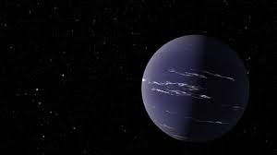



Exploring Exoplanet Atmospheres: Bayesian Analysis for Parameter Estimation
10th Semester Project Presentation
Aliyya Fathima Rinu(1911022)
Project Supervisors:
Dr. Jayesh M Goyal
School of Earth and Planetary Sciences, NISER
Dr. Nabin Kumar Jana
School of Mathematical Sciences, NISER

Slide 2
OVERVIEW
Introduction
Methods and Results
Markov Chain Monte Carlo Technique
Nested Sampling Technique
3. Conclusions
4. Acknowledgment Questions!

Slide 3
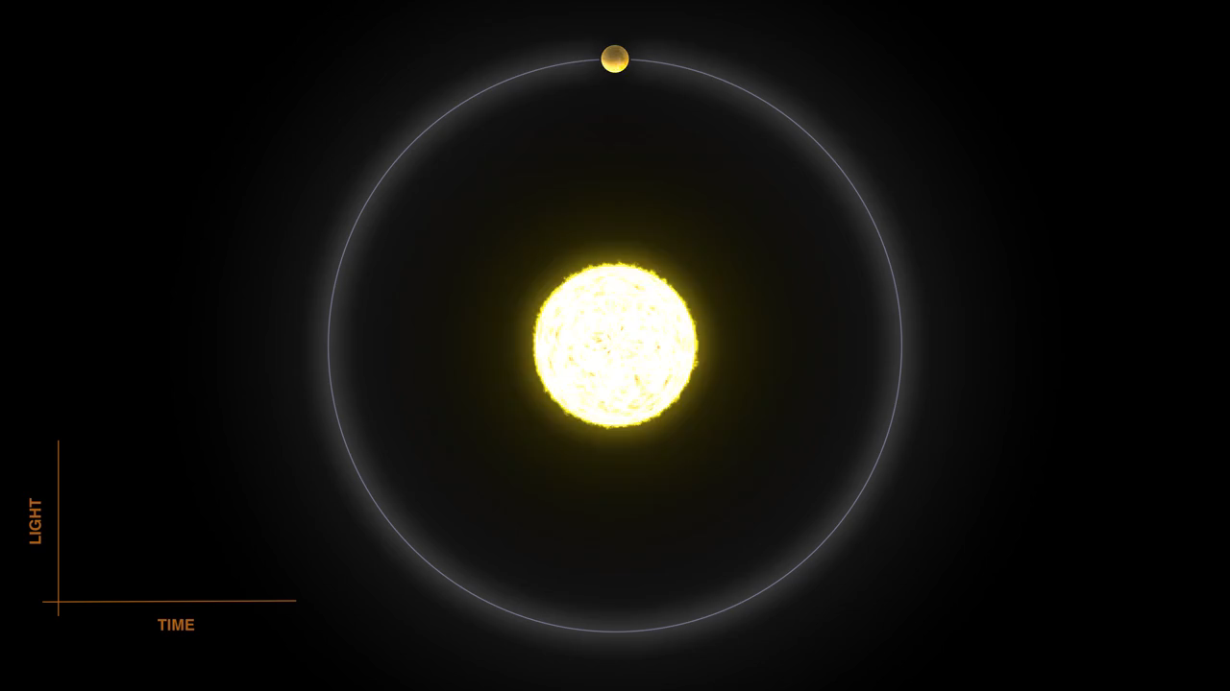
Transmission Spectrum

Slide 4
Simple Representation of the Model
Prior distribution
Parameter Estimations
Model Evidence
Best Fit Model
Retrieval Model
Observed transmission spectrum
Generated spectrum
Forward Model Solves Radiative Transfer Equation and generates Model Spectra

Slide 5
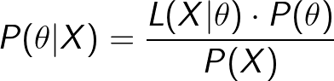
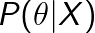
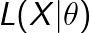
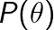
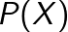
From Traditional Methods to a More Stable Approach
= Posterior probability
= Likelihood Function
= Prior Probability
= Marginal distribution of X over parameter space

Slide 6
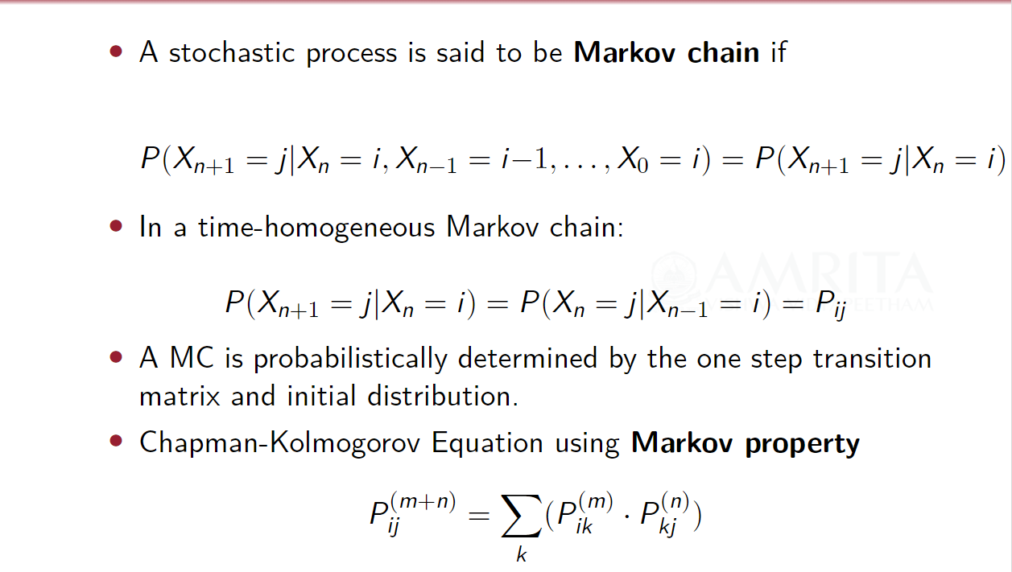
Markov chain

Slide 7
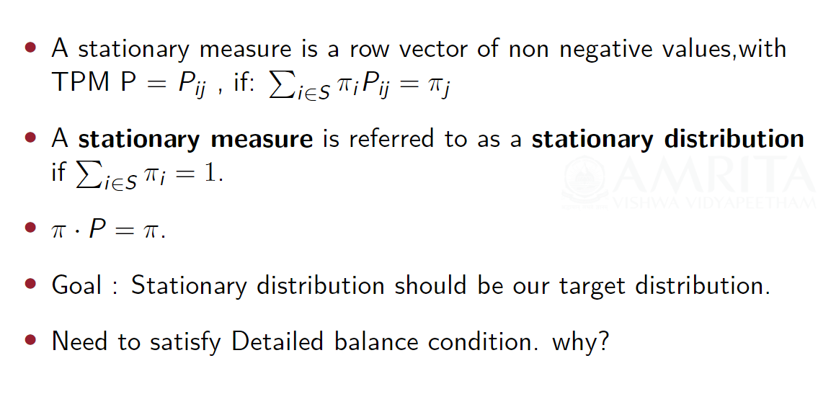
STATIONARY DISTRIBUTIONS

Slide 8
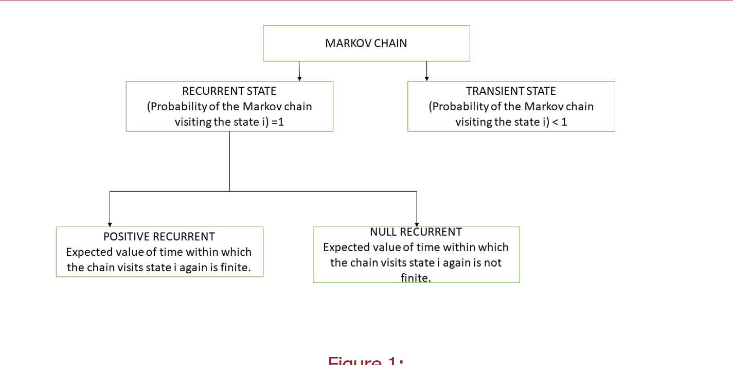
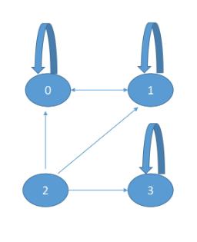
Some Useful Details on Markov chain
Example

Slide 9
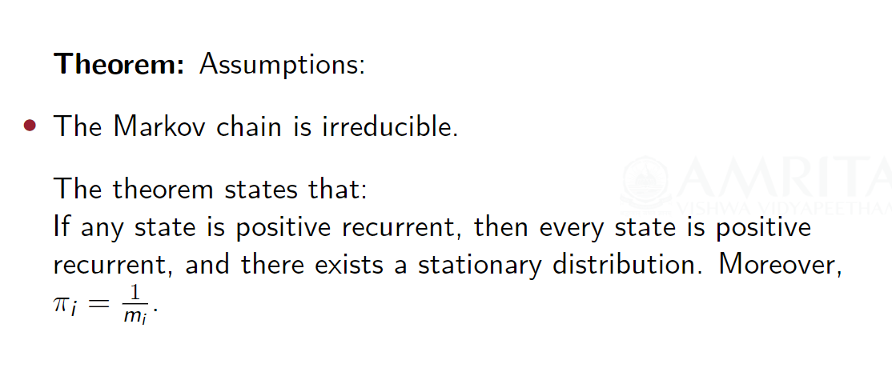
Existence of Stationary Distribution

Slide 10
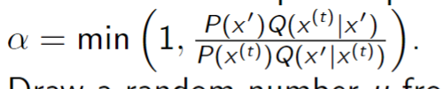
METROPLIS HASTINGS ALGORITHM
Initialize an arbitrary point x⁽⁰⁾.
For each iteration t , do:
Sample a candidate x’ from the proposal distribution Q(x’|x(t)).
Calculate the acceptance probability:
Draw a random number u from the uniform distribution U(0,1).
If u < α
otherwise
Accept the candidate set x^{(t+1)} = x’
set x^{(t+1)} = x^{(t)}
Collect all accepted samples

Slide 11
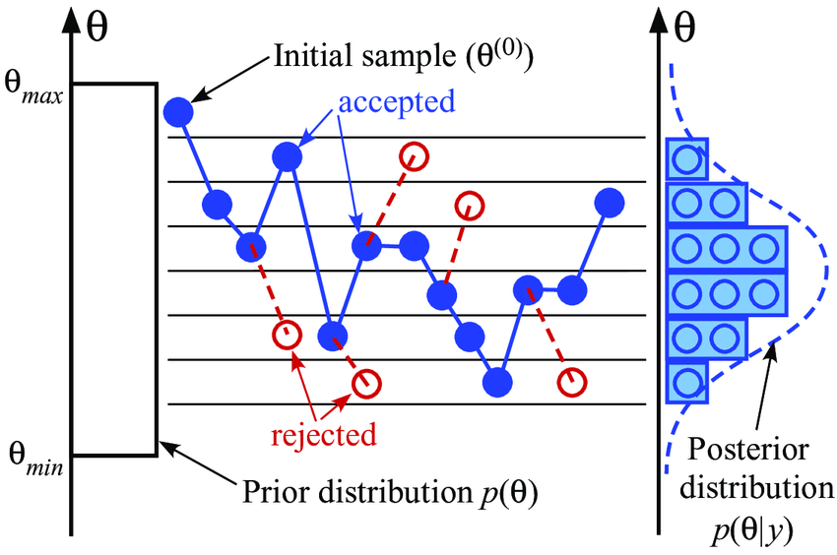
X
Source:Wikipedia

Slide 12
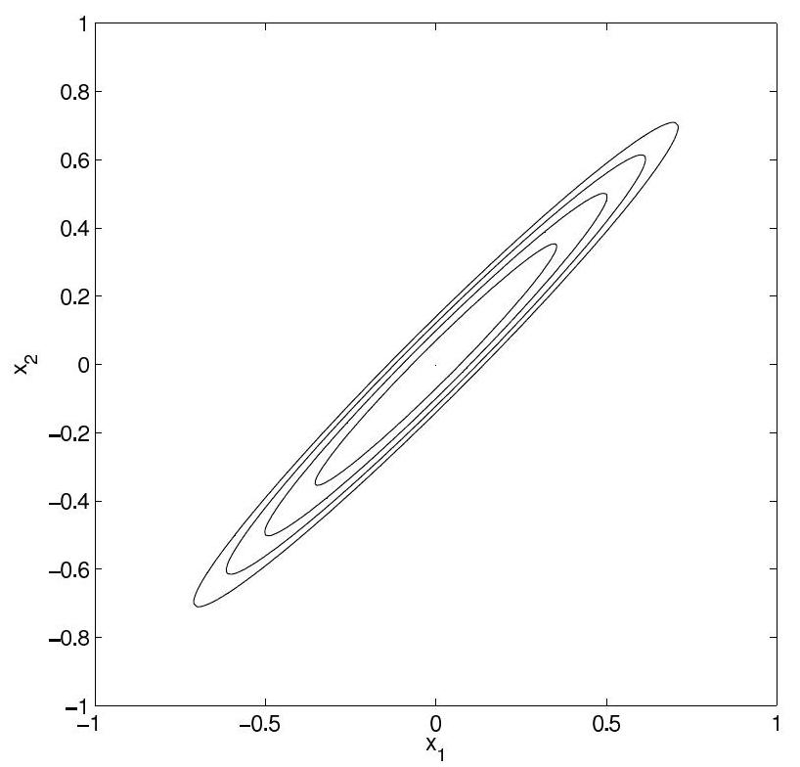
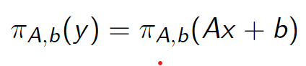
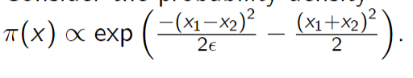

Affine Invariance in MCMC Sampling
Performance of MCMC sampling methods may vary for scaled densities, leading to slow equilibration.
Example: Scaled Posterior Distribution
An affine transformation is an invertible mapping from ${\text{ℝ}}^{n}$ to ${\text{ℝ}}^{n}$ of the form y = Ax + b. If X has the probability density $π$(x), then Y = AX + b has density;
The target probability density for the ensemble is the one in which the walkers are independent and drawn from $π$, i.e,
Source: ENSEMBLE SAMPLERS WITH AFFINE INVARIANCE JONATHAN GOODMAN AND JONATHAN WEARE

Slide 13
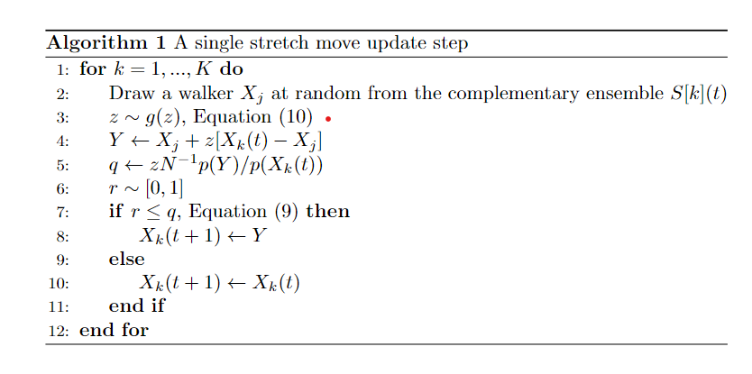
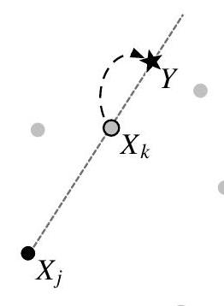
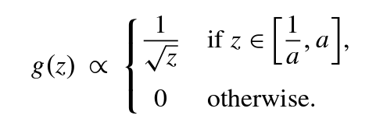
^N-1
where the parameter a > 1 can be adjusted to improve performance.

Slide 14
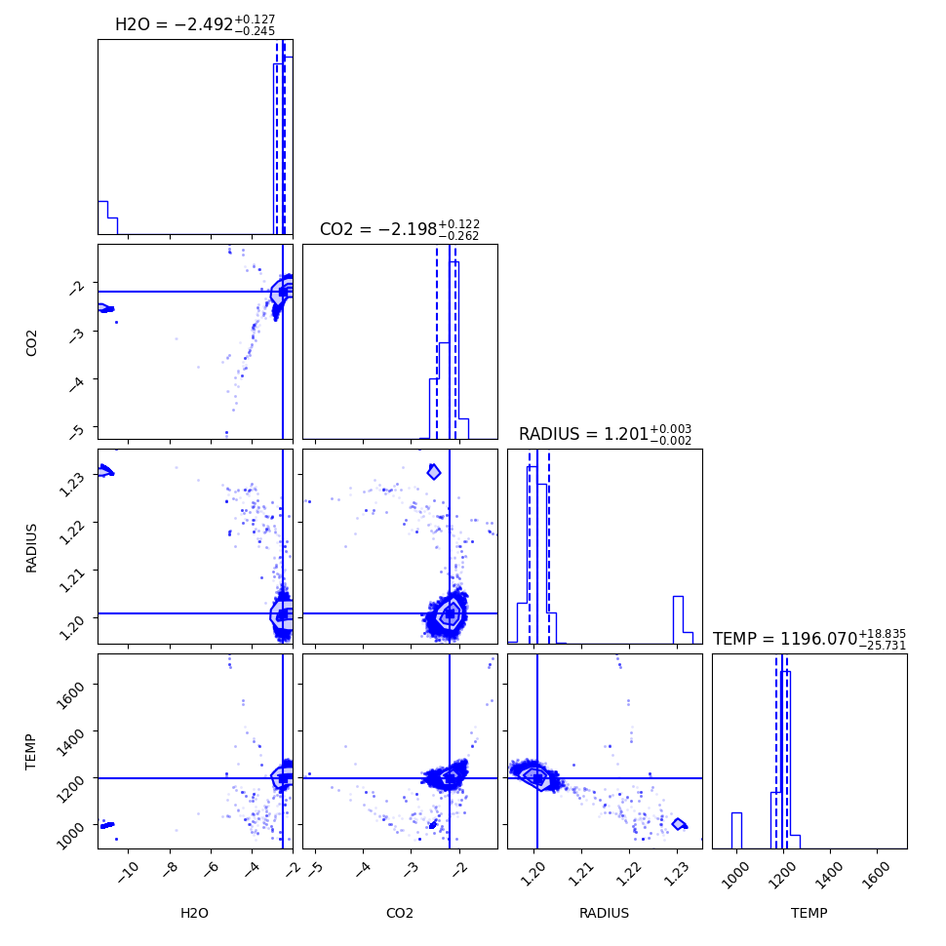
Retrieved Posterior distribution using generated transmission spectrum (standard test) with median and error (2σ) labelled.
True parameter values used for generating the Input data for standard test: H2O – 0.34% = 10^(-2.5) radius – 1.2 R_jup Temperatue – 1200 k

Slide 15
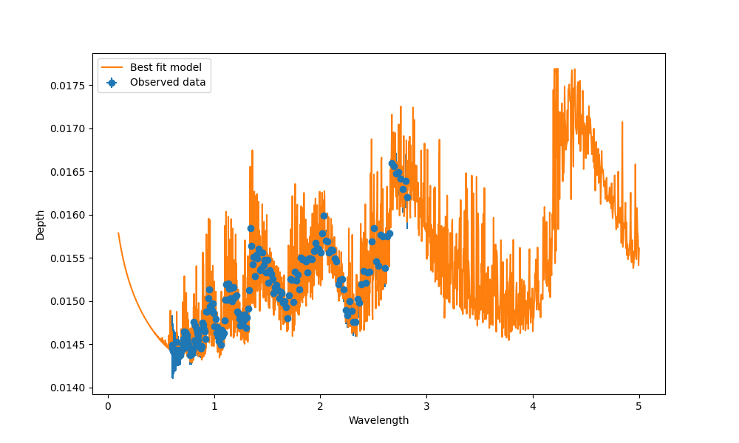
Best fit Model
Reduced Chi-squared value : 0.000128

Slide 16
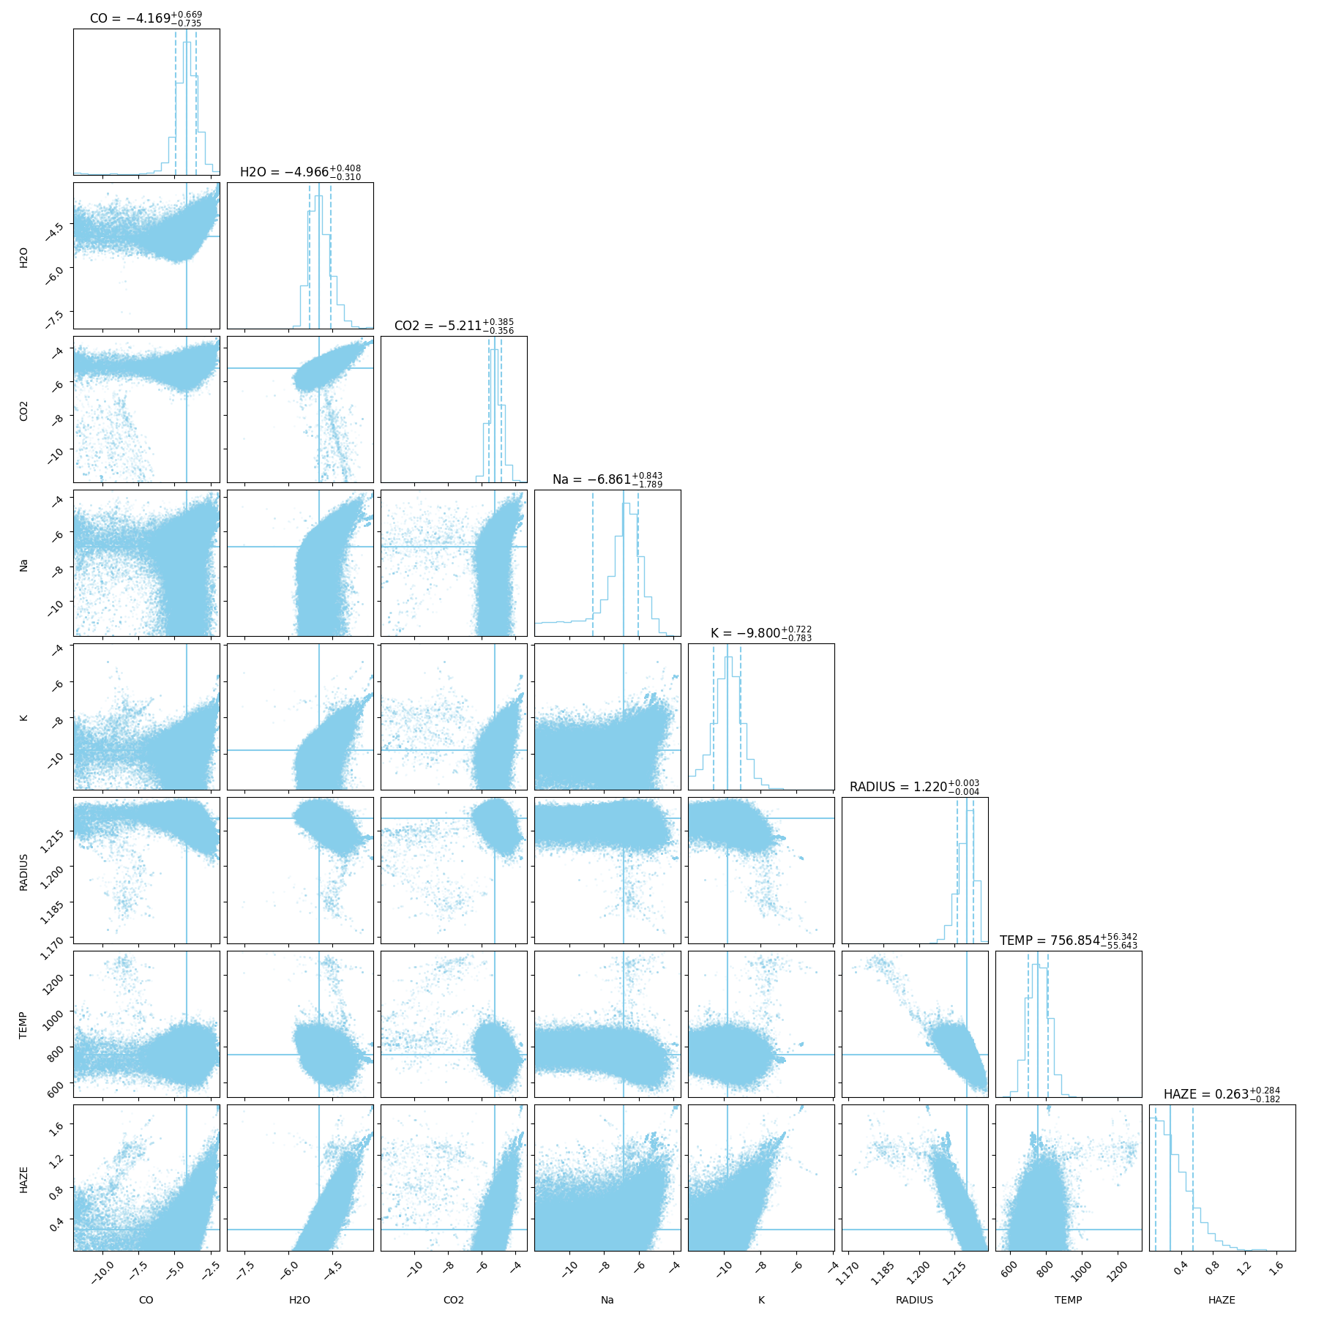
Retrieved Posterior distribution using emcee (8 parameters)
Retrieved using the retrieval model without considering cloud parameters.

Slide 17
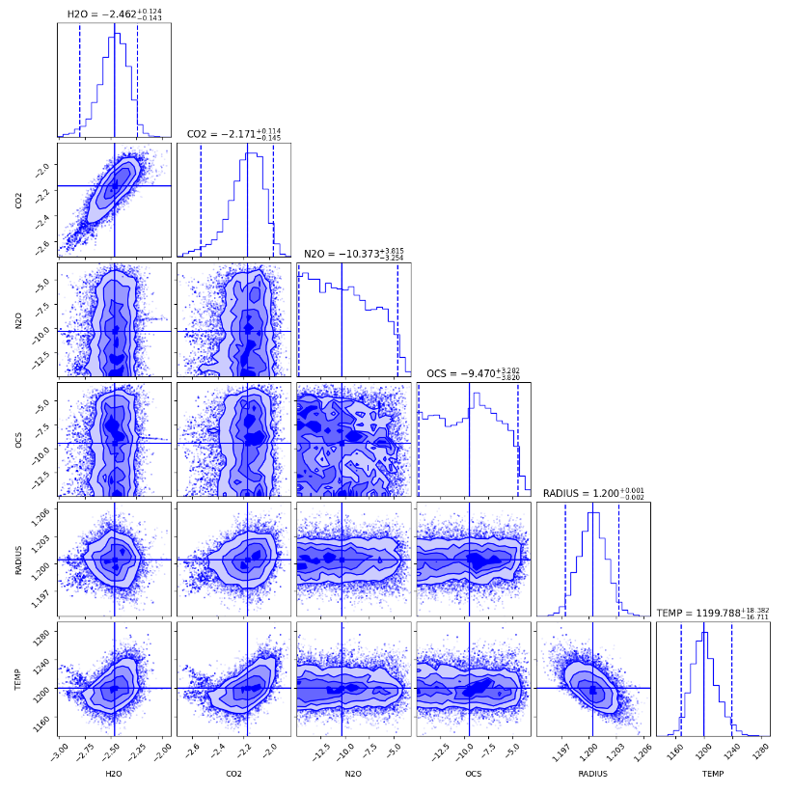
Testing for the marginal values using Std data
True parameter values used for generating the Input data for standard test: H2O – 0.34% radius – 1.2 R_jup Temperatue – 1200 k N2O --- -9.8

Slide 18
Alternative Techniques??

Slide 19
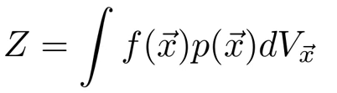
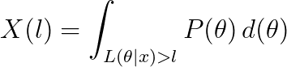
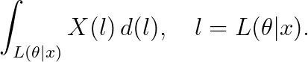
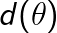

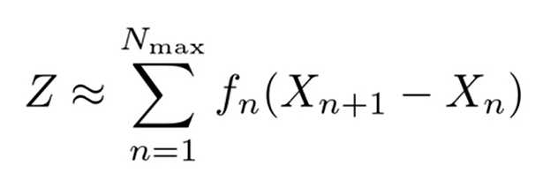
NESTED SAMPLING
Z =
X(l) – Restricted Prior mass
N DIMENSIONAL INTEGRAL
1 DIMENSIONAL INTEGRAL
ORDER STATISTICS !!
?
Notes:
Nested sampling transforms the higher dimensional lebesgue integral to 1d

Slide 20
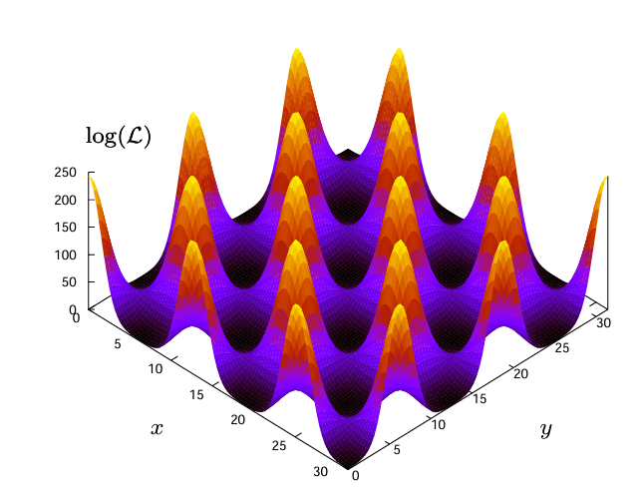
What do we know about the posterior distributions?
Source: MULTINEST:an efficient and robust Bayesian inference tool for cosmology and particle physics

Slide 21
pymultinest
Calculates the evidence with an associated error estimate.
Produces posterior samples from distributions that may contain multiple modes.
Handles pronounced (curving) degeneracies in high dimensions.

Slide 22
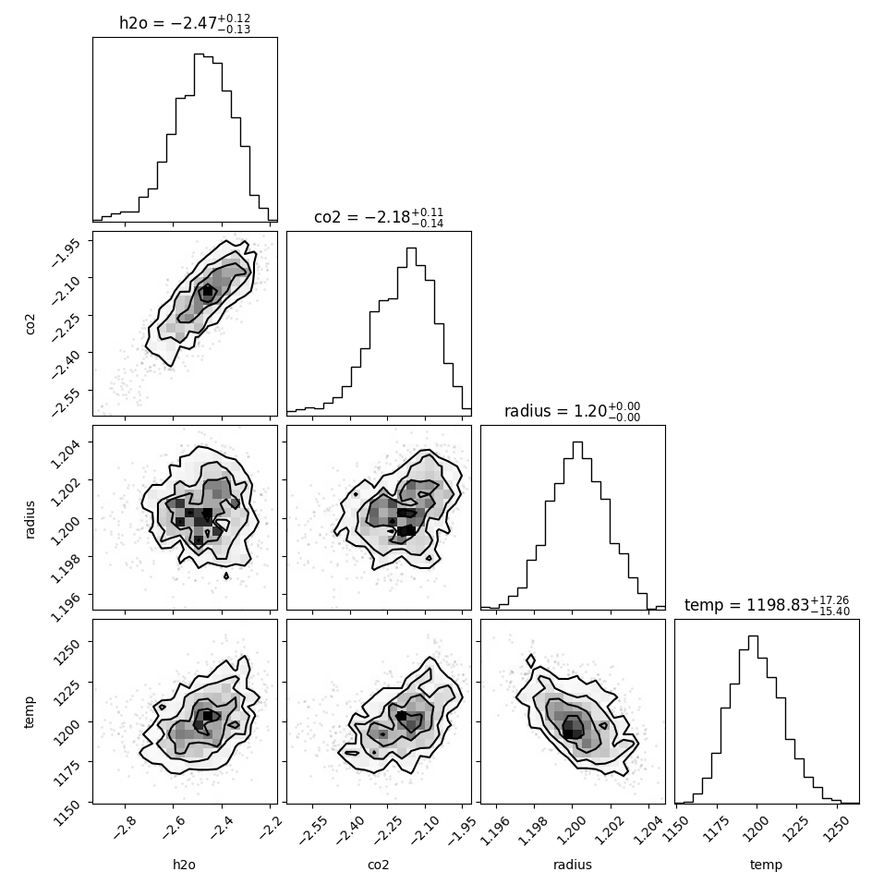
True parameter values used for generating the Input data for standard test: H2O – 0.34% radius – 1.2 R_jup Temperatue – 1200 k
Retrieved Posterior distribution using generated transmission spectrum (standard test) with median and error (2sigma) labeled.

Slide 23
Best fit Model
Reduced Chi-squared value : 0.00039

Slide 24
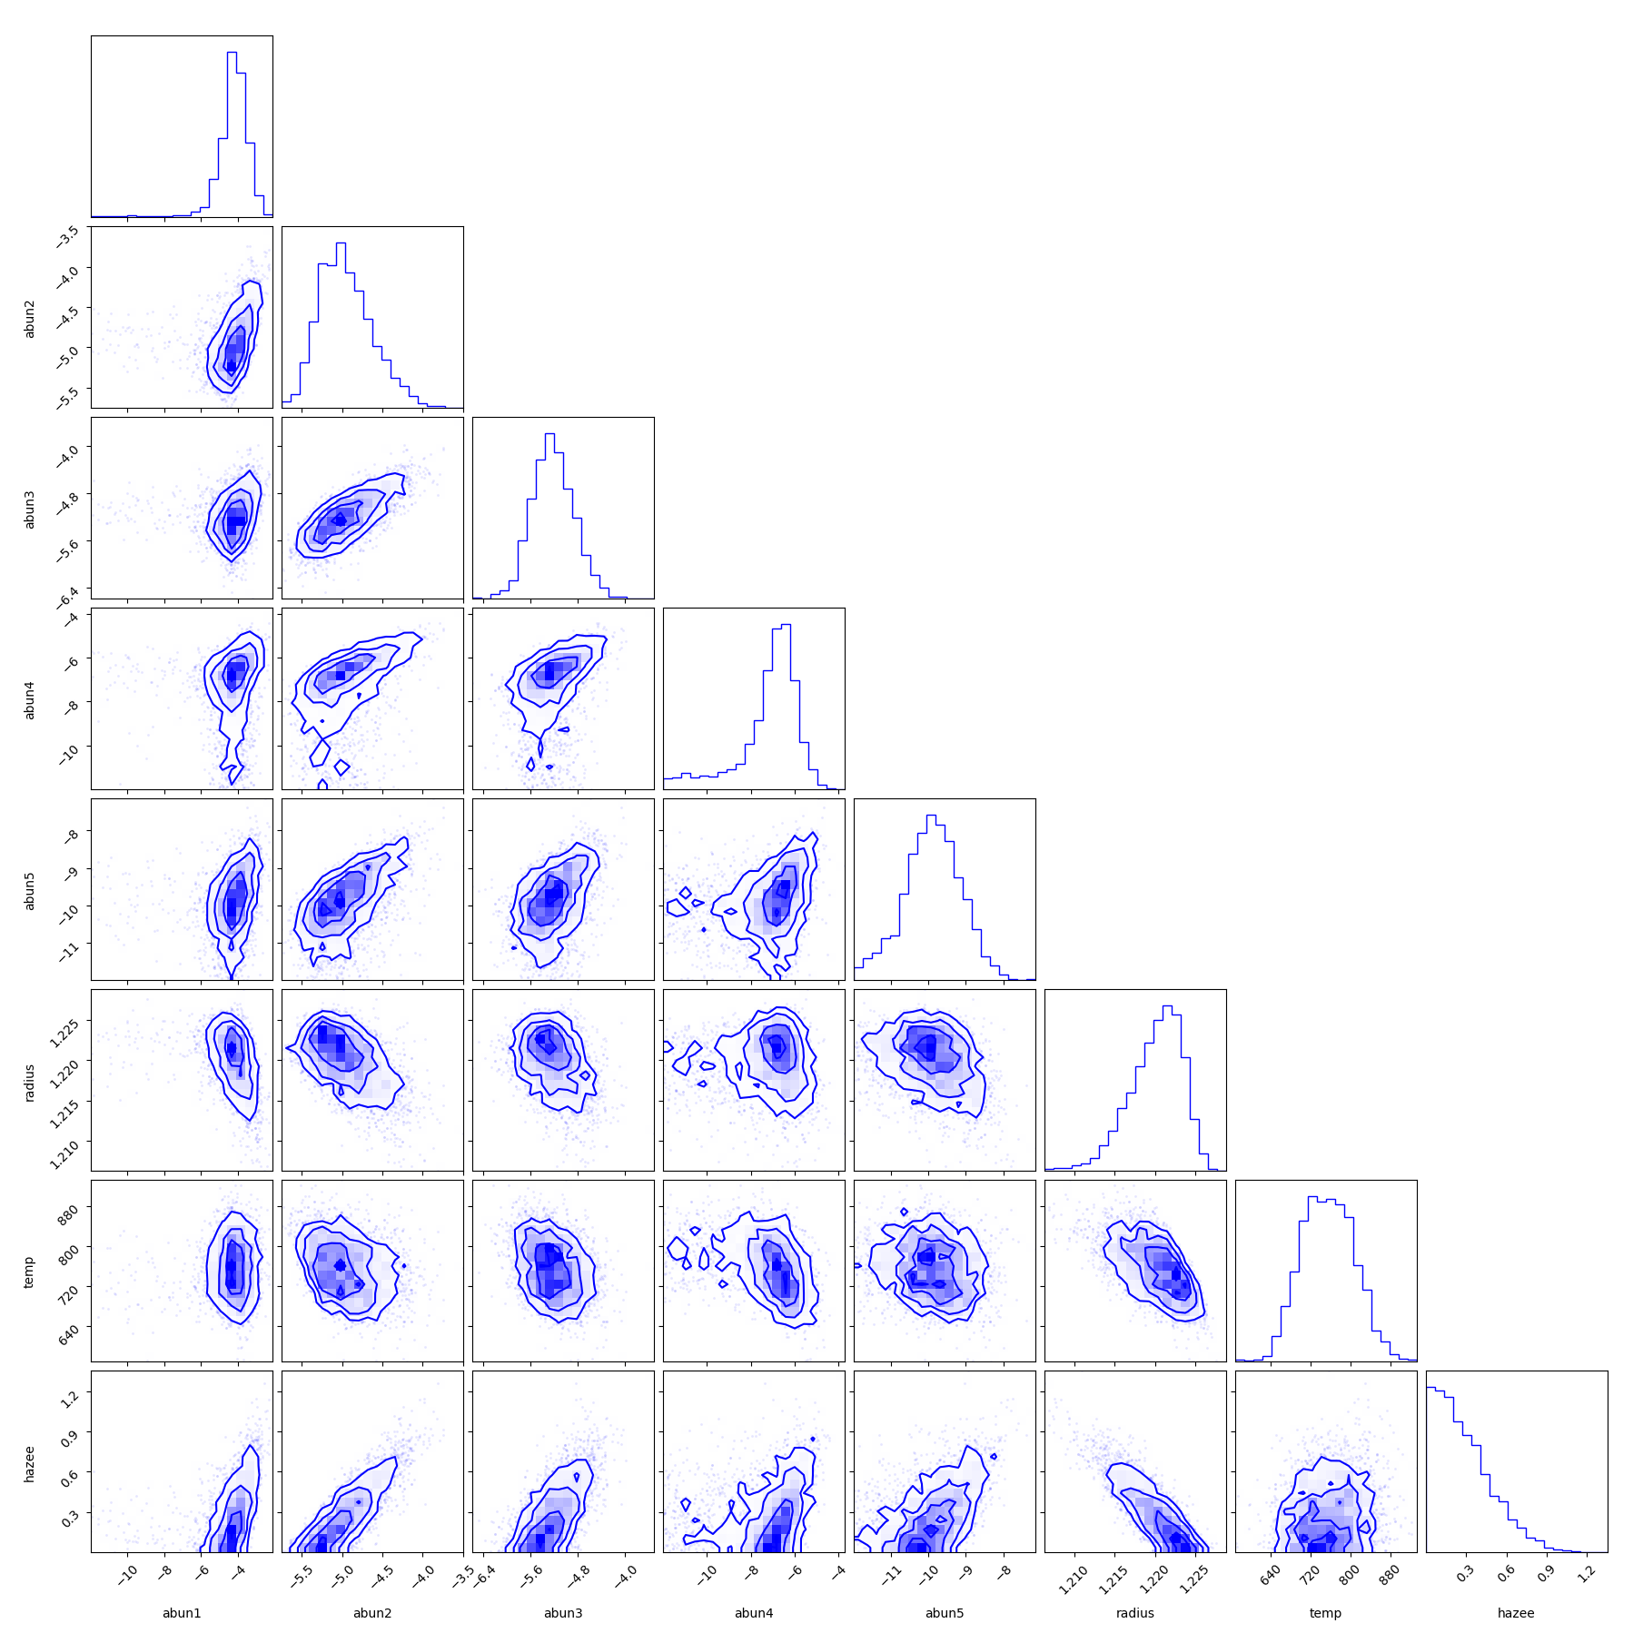
Retrieved Posterior distribution using pymultinest (8 parameters)
Retrieved using the retrieval model without considering cloud parameters.
Parameters | Median | Error(2σ)
CO | -2.647 | +0.36
 |  | -0.53
H₂O | -3.921 | +0.11
 |  | -0.13
CO₂ | -4.356 | +0.25
 |  | -0.27
Na | -6.086 | +0.41
 |  | -0.61
K | -8.309 | +0.60
 |  | -0.63
Radius | 1.210 | +0.01
 |  | -0.01
Temperature | 791.4 | +98.78
 |  | -84.25
Haze | 1.107 | + 0.83
 |  | -0.12

Slide 25
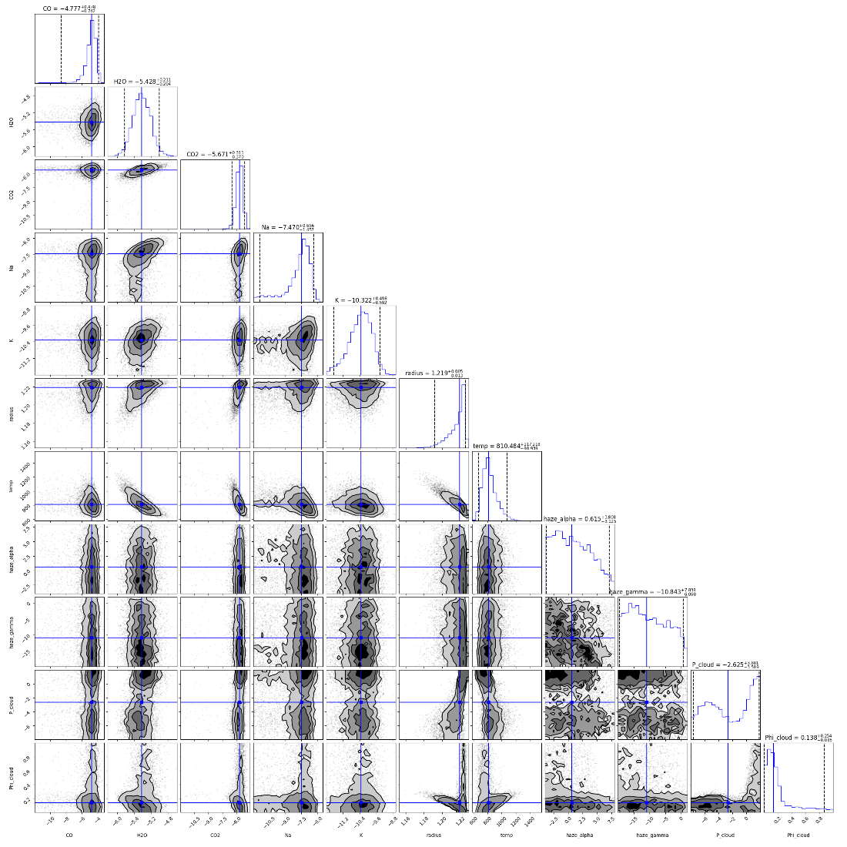
Retrieved Posterior distributions using WASP96b Transmission spectrum(11parameters)

Slide 26
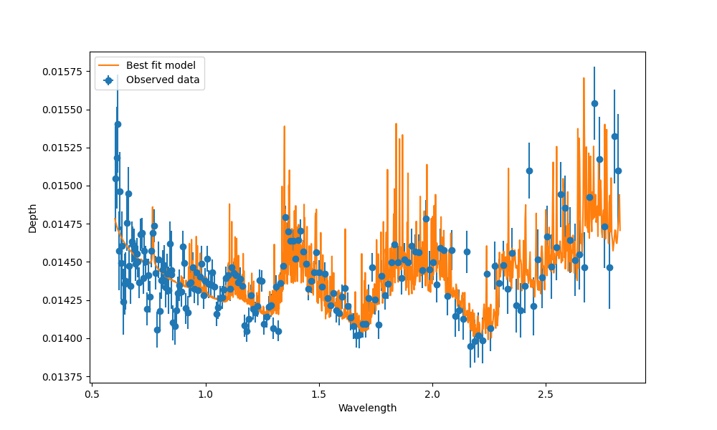
Best Fit Model for 11 Parameters
Reduced chi-squared value: 1.75369

Slide 27
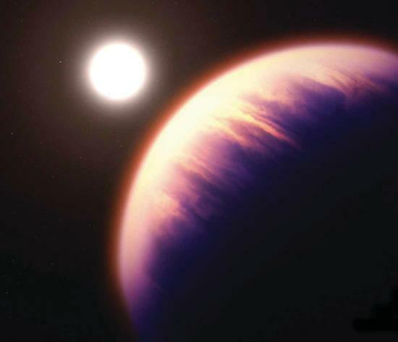
CONCLUSIONS

Slide 28
Comparison Table (Std Test)
Parameters | MCMC |  |  | Nested Sampling
 | Median |  | Error | Median | Error
H₂O | -2.49 | +0.12 |  | -2.47 | +0.12
 |  | -0.245 |  |  | -0.13
CO₂ | -2.2 | +0.122 |  | -2.2 | +0.11
 |  | -0.262 |  |  | -0.14
Radius | 1.2 | +0.003 |  | 1.2 | +0.00
 |  | -0.002 |  |  | -0.00
Temperature | 1196.07 | +18.835 |  | 1194.75 | +17.26
 |  | -25.731 |  |  | -15.40
TRUE VALUES USED FOR STD TEST H₂O = 0.34%
Radius = 1.2 R_Jup,
Temperature=1200K,

Slide 29
Comparison Table for 8 parameter case.
Parameters | Median (MCMC) | Error | Mean(NS) | Error
CO | -4.169 | +0.669 | -2.647 | +0.36
 |  | -0.735 |  | -0.53
H₂O | -4.966 | +0.408 | -3.921 | +0.11
 |  | -0.310 |  | -0.13
CO₂ | -5.211 | +0.385 | -4.356 | +0.25
 |  | -0.3506 |  | -0.27
Na | -6.861 | +0.843 | -6.086 | +0.41
 |  | -1.789 |  | -0.61
K | -9.800 | +0.722 | -8.309 | +0.60
 |  | -0.783 |  | -0.63
Radius | 1.220 | +0.003 | 1.210 | +0.01
 |  | -0.004 |  | -0.01
Temperature | 756.854 | +56.342 | 791.4 | +98.78
 |  | -55.643 |  | -84.25
Haze | 0.263 | +0.284 | 1.107 | + 0.83
 |  | -0.182 |  | -0.12

Slide 30
Table for 11 parameters case
Parameters | Median (NS) | Error
CO | -4.777 | +0.478
 |  | -0.742
H₂O | -5.428 | +0.211
 |  | -0.204
CO₂ | -5.671 | +0.311
 |  | -0.370
Na | -7.470 | +0.656
 |  | -1.457
K | -10.322 | +0.498
 |  | -0.592
Radius | -1.219 | +0.005
 |  | -0.013
Parameters | Median (NS) | Error
Temperature | 810.464 | +117.218
 |  | -80.939
Haze_alpha | 0.615 | +3.808
 |  | -3.125
Haze_gamma | -10.843 | +7.838
 |  | -6.060
P_Cloud | -2.625 | +3.801
 |  | -3.509
Phi_Cloud | 0.138 | +0.254
 |  | -0.085

Slide 31
Conclusions
MCMC chains often get stuck at local modes, whereas MULTINEST excels at identifying these modes within the posterior distribution.
MULTINEST converges faster than MCMC
In higher dimensions, MULTINEST's reliability can be compromised due to errors incurred by using order statistics to estimate the enclosed volume, which is used as a weight in evidence calculations.
Conversely, MCMC samples directly from the target distributions, potentially offering greater reliability in higher dimensions.
MCMC could achieve high computational efficiency if parallelized without violating the detailed balance condition.
Both methods yielded favorable results in tests for marginal distribution

Slide 32
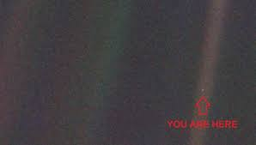
Acknowledgement
“Look again at that dot. That's here. That's home. That's us. On it everyone you love, everyone you know, everyone you ever heard of, every human being who ever was, lived out their lives……” ------ Carl Sagan
I would like to acknowledge my supervisors Dr. Nabin Kumar Jana and Dr. Jayesh M Goyal.
I am also grateful to my parents and friends for all the support and encouragement they have given.
I would like to extend my acknowledgement to NISER and DAE for funding me through DISHA.

Slide 33
THANK YOU

